Slide 1
FTE Application-SWE Name: Zhiqiang Zhou Manager: Alex Qiu Mentor: Nanxuan Xu Date: 8/22 2016

Slide 2
Agenda
Background and Key Metrics in Dashboard
Dashboard Demonstration
Workflow Introduction
Q & A

Slide 3

Contribution Funnel (July)
WEDCS Visitors
2.9m (100%)
6.5k (0.23%)
Contribution Link Clickers
PR Initiators
111 (1.70%)
106 (95.5%)
Accepted
How to increase the percentage？

Slide 4
Key Metrics
Publish
A
Actions (Create/Delete/Update/Rename) on one or more topics.
Pull Request
Contribution & Contributor
Mechanism for proposing and collaborating on changes to a repository.
B
C
People who make a commit, open an issue or propose a pull request.

Slide 5
DASHBOARD
DEMONSTRATION

Slide 6
Benefits of The Dashboard
Offer a unified place to present the overall contribution situation
Help to judge whether a hypothesis is feasible and efficient
Help to make further hypothesis

Slide 7



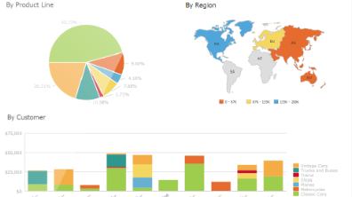
Workflow
STAGE ONE
STAGE TWO
STAGE THREE
STAGE FOUR
Extracting Data
Parsing Data
Loading Data
Visualizing Data
Acquire JSON data from GitHub and VSO by calling Rest API.
Parse the JSON data to get the information we need.
Inserting the information to the tables created in the database.
Make the data visualized in dashboard by PowerBI.

Slide 8
Challenges in The Workflow
Gather data that is missing
Complement the incomplete data
Data processing
Pull request of VSO repositories
Topic Localization
Format the data so that it can be well displayed in dashboard.
Design algorithm to get the count of insertions and deletions by words.

Slide 9
THANK YOU
FOR LISTENING

Slide 10
Q & A

Slide 11
Publish Categorization
The number of topics updated in a single publish.
Topic
The action of the user for a single topic: create, delete, update, rename or not explicitly known.
Action
The number of changed lines (insertions or deletions) of a single topic when a user action happens.
Code Lines

Slide 12
Pull Request Categorization
The number of commits in a single pull request.
Commit
The status of a single pull request: successfully merged, rejected or being active now.
Status
The time duration for a single pull request from being created to being merged.
Duration

